Slide 1
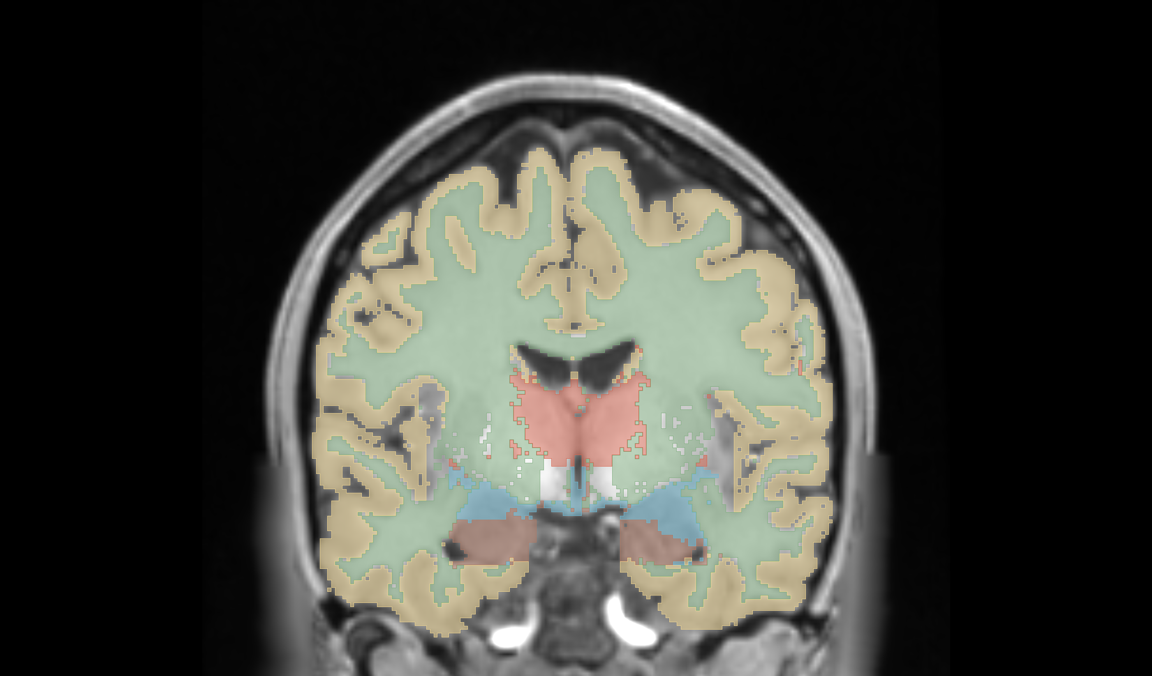
Hypothesis 6 - Feature Extraction -
Severin Willingsdorfer, Riccardo Dirnberger,
Niklas Freudiger

Slide 2
Hypothesis 6: A larger amount of features improves the segmentation performance

Slide 3
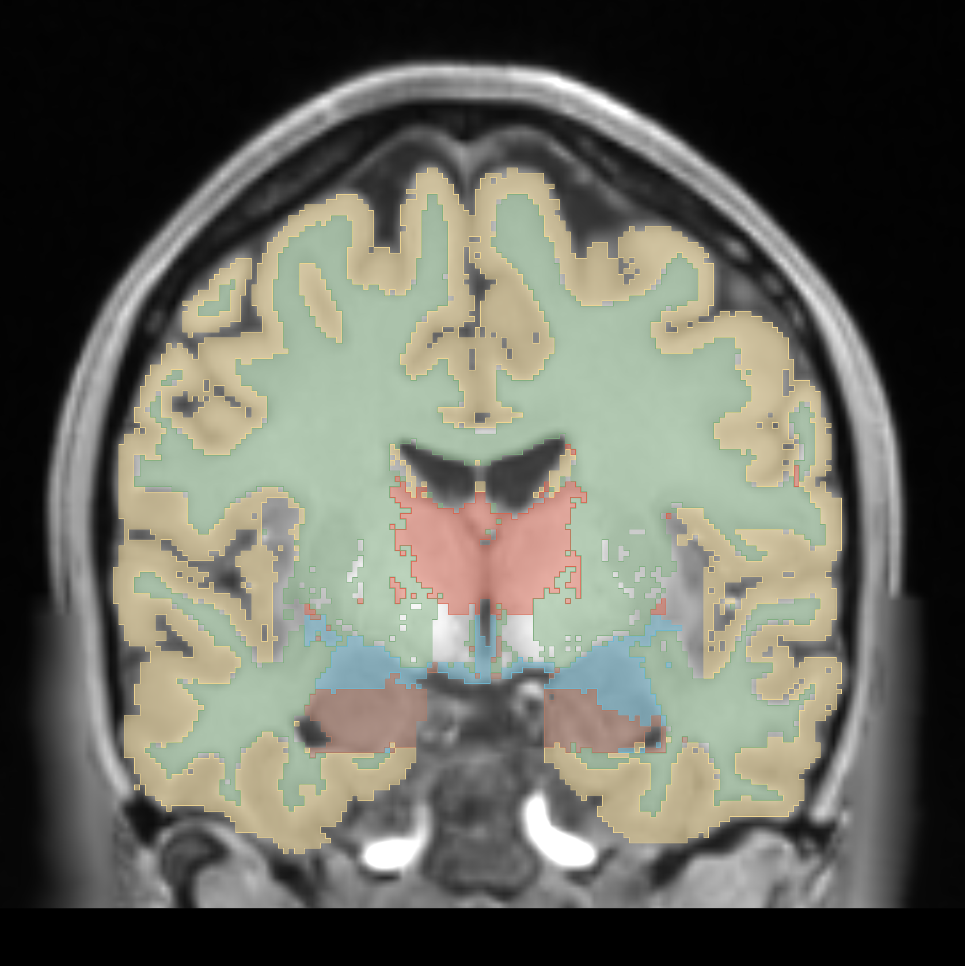
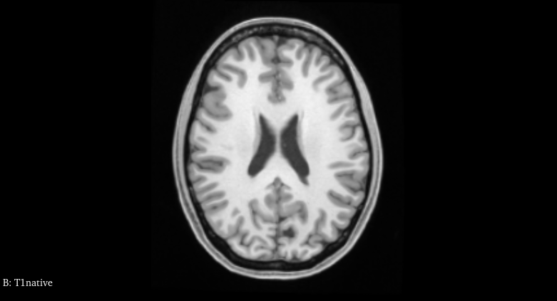
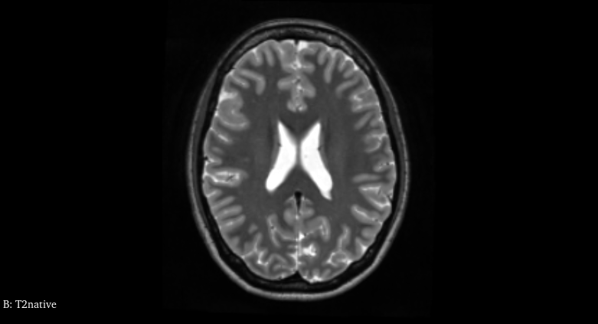
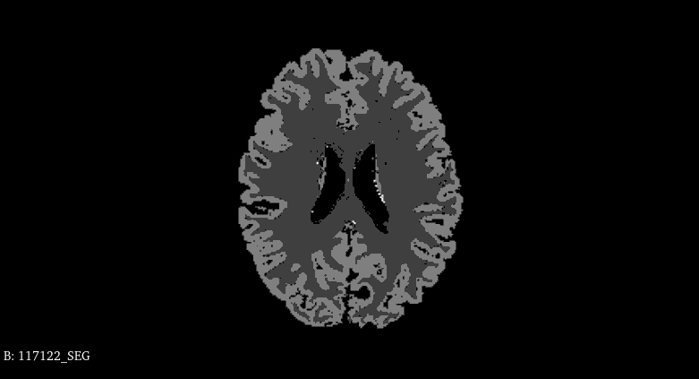
Training Data
Segmentation
T1w
T2w
Registration
Preprocessing
Feature Extraction
Classification
Postprocessing
Evaluation

Slide 4
Training Data
Segmentation
T1w
T2w
Registration
Preprocessing
Feature Extraction
Classification
Postprocessing
Evaluation

Slide 5
Training Data
Segmentation
T1w
T2w
Registration
Preprocessing
Feature Extraction
Classification
Postprocessing
1
2
3
Evaluation
4

Slide 6
1
2
Feature Extraction
3
4
Evaluation
Registration, Preprocessing
Classification
Training Data
Segmentation

Slide 7
1
2
Feature Extraction
3
4
Evaluation
Registration, Preprocessing
Classification
Features
T1w
T2w
Coordinate (C)
Intensity (I)
Gradient Intensity (G)
Neighbourhood (NH)
Training Data
Noise (GA & SP)
Segmentation

Slide 8
1
2
Feature Extraction
3
4
Evaluation
Registration, Preprocessing
Classification
Features
T1w
T2w
Coordinate (C)
Intensity (I)
Gradient Intensity (G)
Neighbourhood (NH)
Training Data
Noise (GA & SP)
Segmentation
Combinations
0.
1.
5.
2.
6.
3.
7.
4.
8.
9.
10.
11.
12.

Slide 9
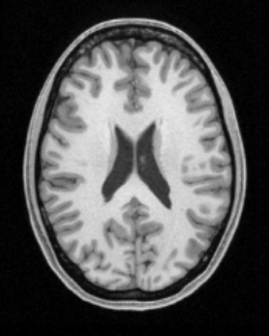
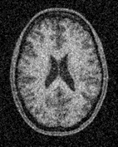
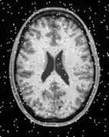
1
2
Feature Extraction
3
4
Evaluation
Registration, Preprocessing
Classification
Features
Testing Data
T1w
T2w
Coordinate (C)
Intensity (I)
Baseline
Gradient Intensity (G)
Neighbourhood (NH)
Training Data
Noise (GA & SP)
Segmentation
Combinations
Gaussian Noise
0.
1.
5.
2.
6.
3.
7.
Salt & Pepper Noise
4.
8.
9.
10.
11.
12.

Slide 10
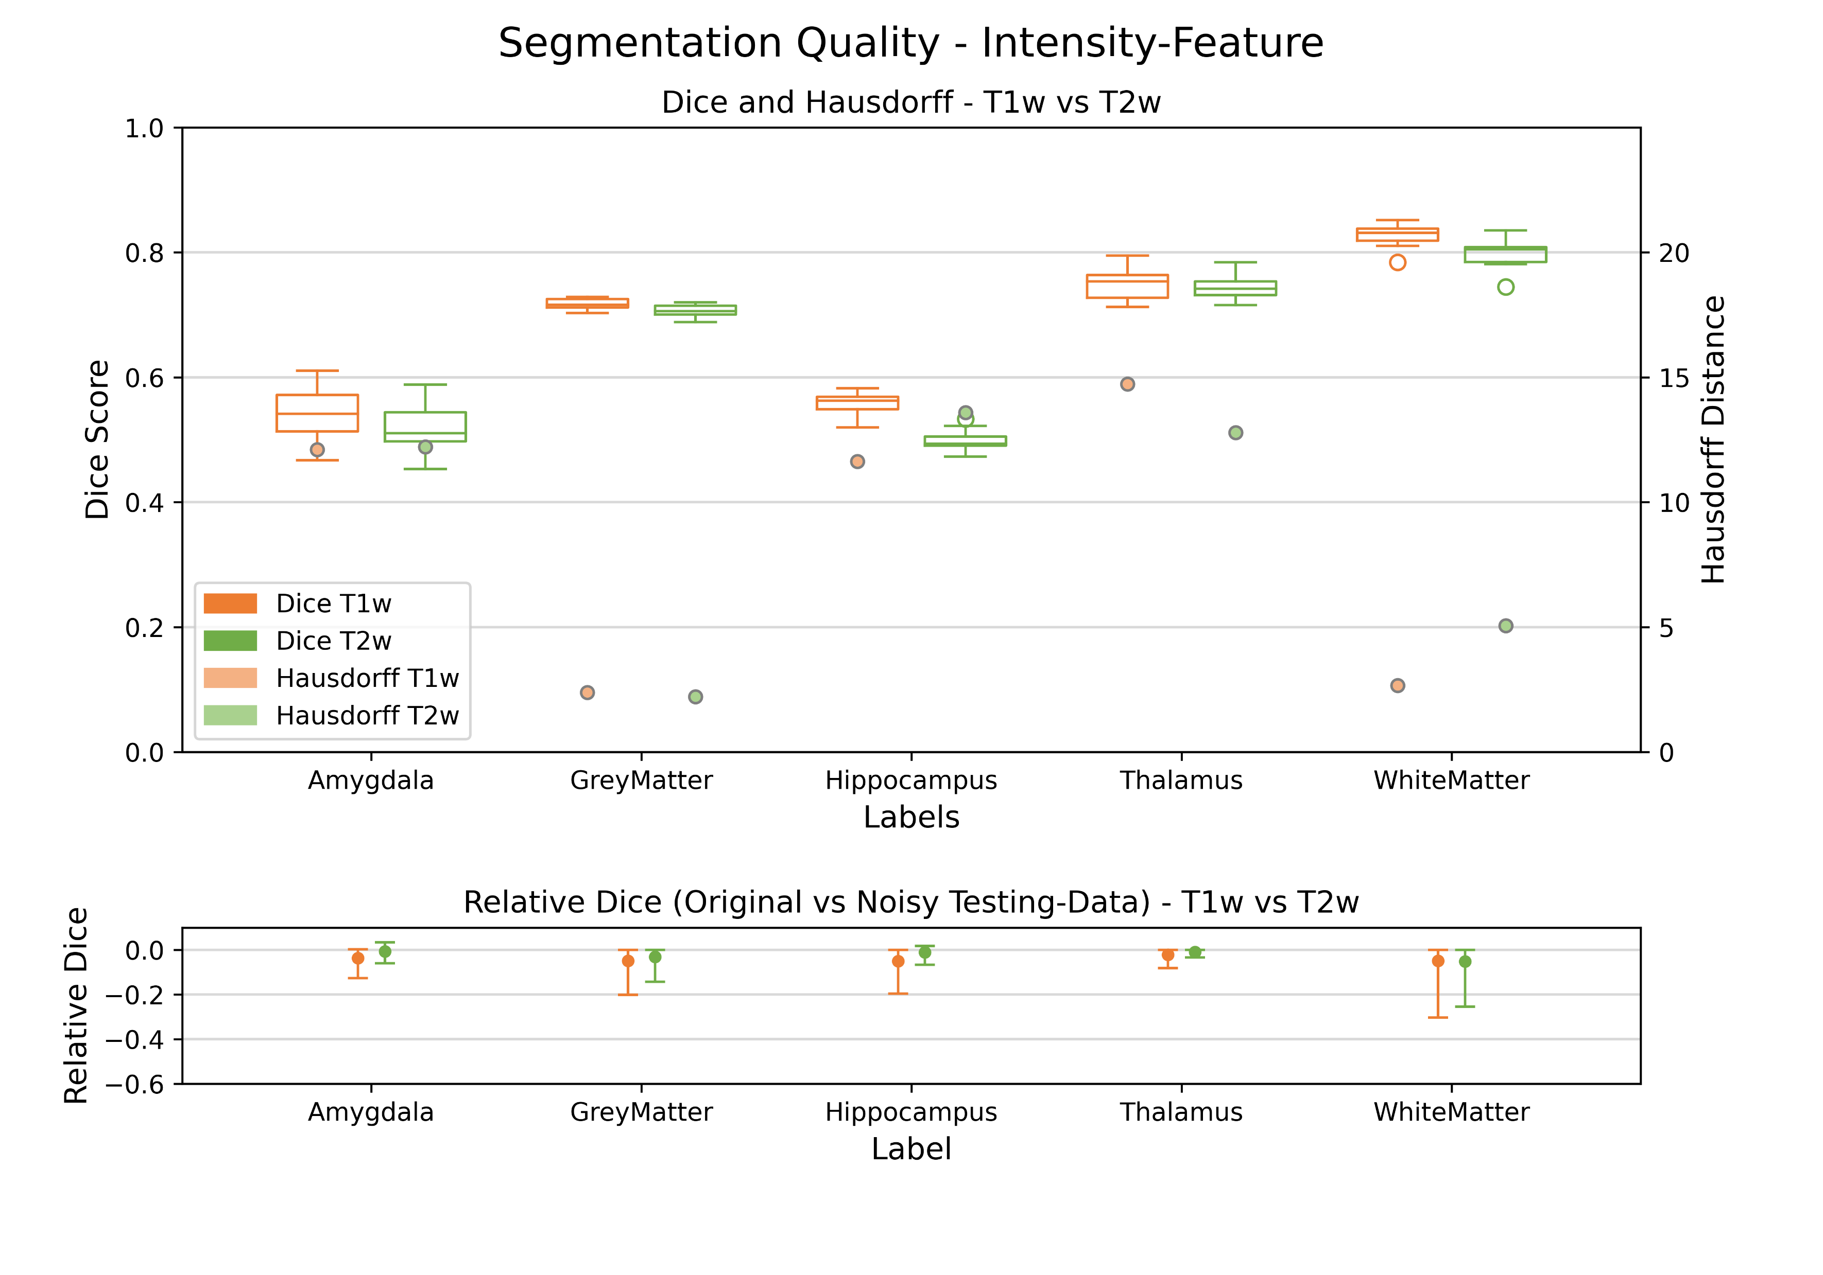
Features
- Intensity
- Gradient
- Neighbourhood
- All three
Notes:
- explain the graph (dice, hausdorff, robustness)
- robustness – applied gaussian and salt/pepper noise
- general Intensity has a good dice but bad robustness

Slide 11
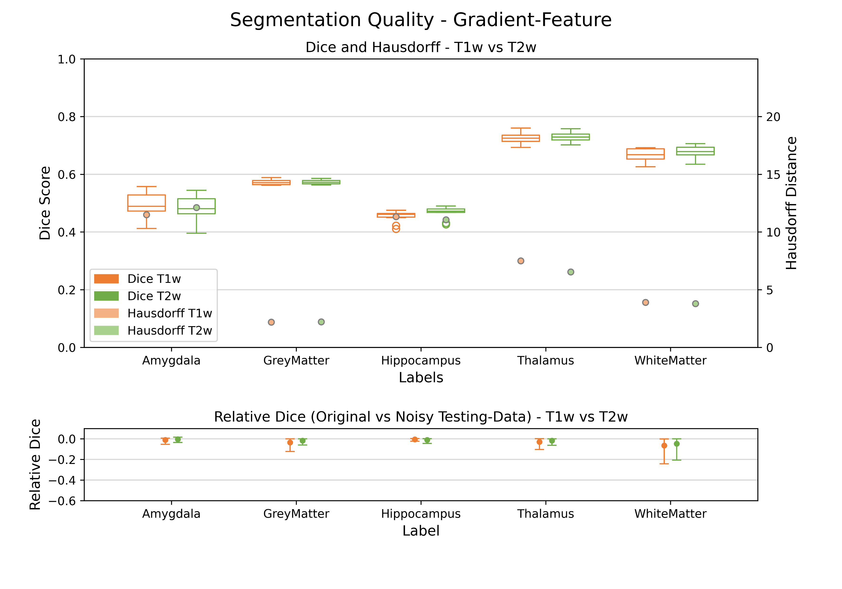
Features
- Intensity
- Gradient
- Neighbourhood
- All three
Notes:
- gradient feature - worst feature at single performance
-> but good robustness

Slide 12
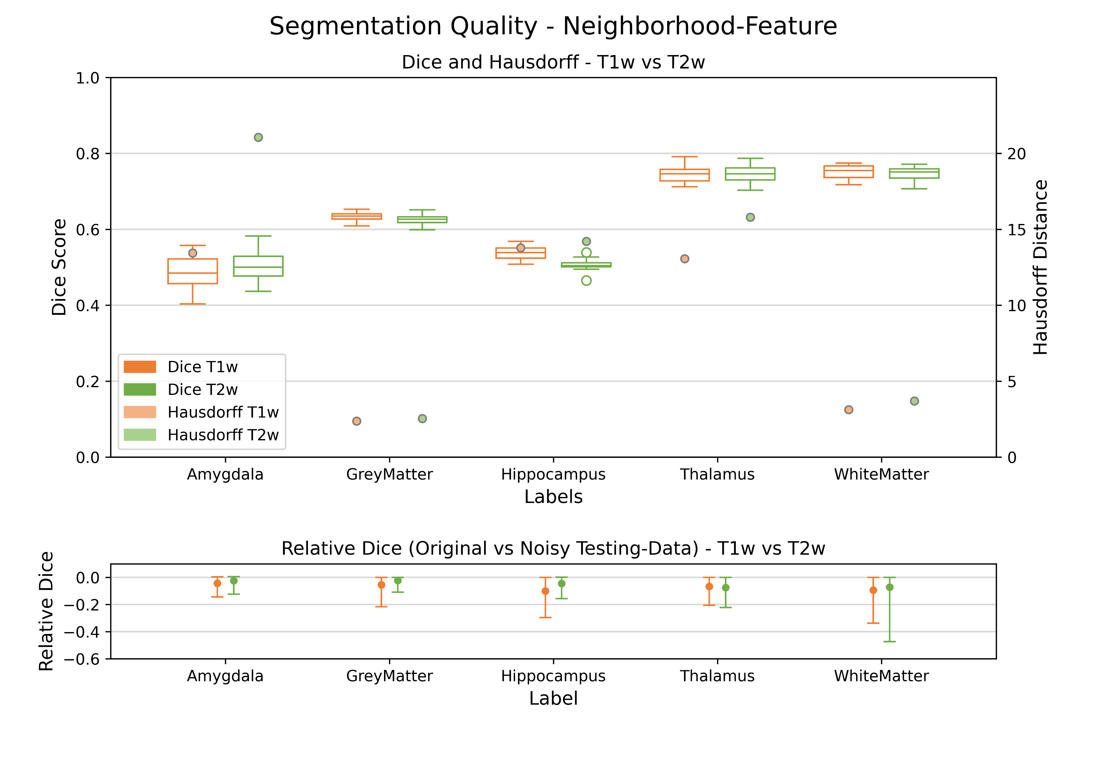
Features
- Intensity
- Gradient
- Neighbourhood
- All three
Notes:
- Neighborhood is better than G but worser than I
-> robustness is the worst
- hausdorff amygdala is very high

Slide 13
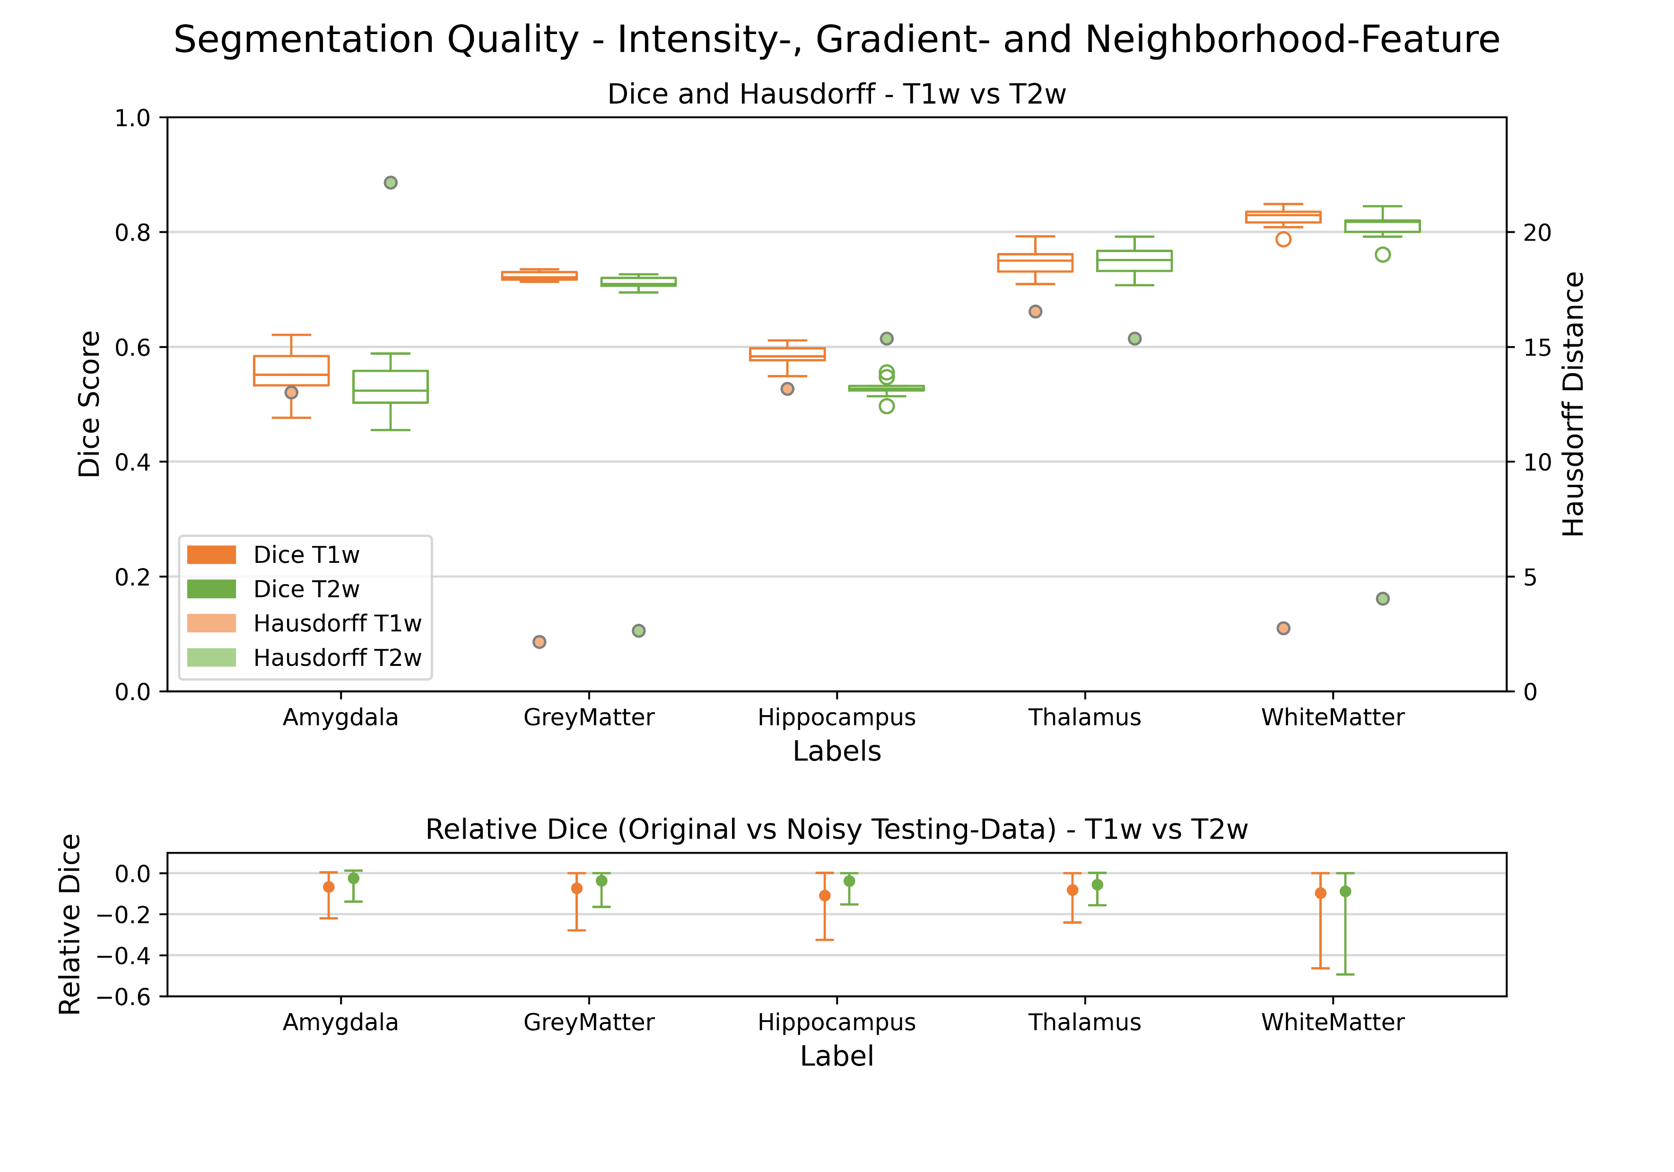
Features
- Intensity
- Gradient
- Neighbourhood
- All three
Notes:
- if we combine all together
-> T1 slightly better
-> robustness of T2 is better

Slide 14
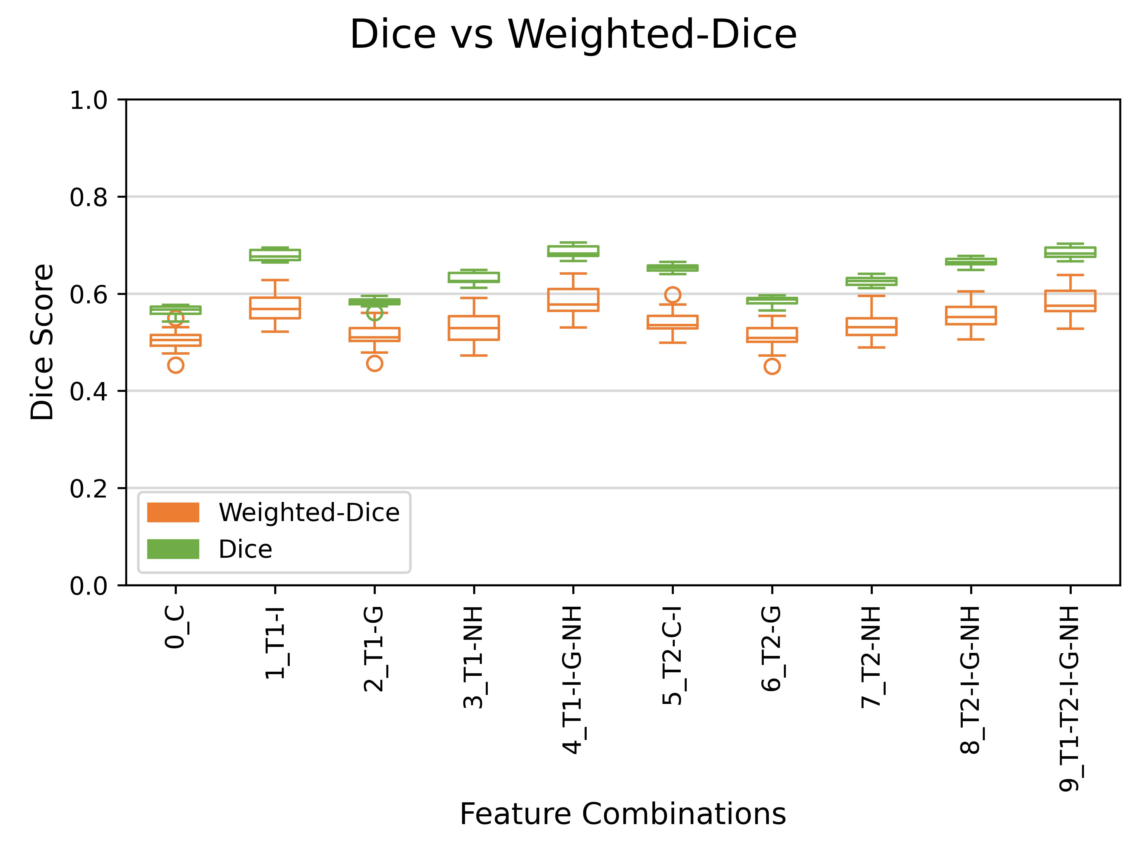
Notes:
- what is the Weighted-Dice - Weighted-Dice 10 data points
- Dice 50 data points

Slide 15
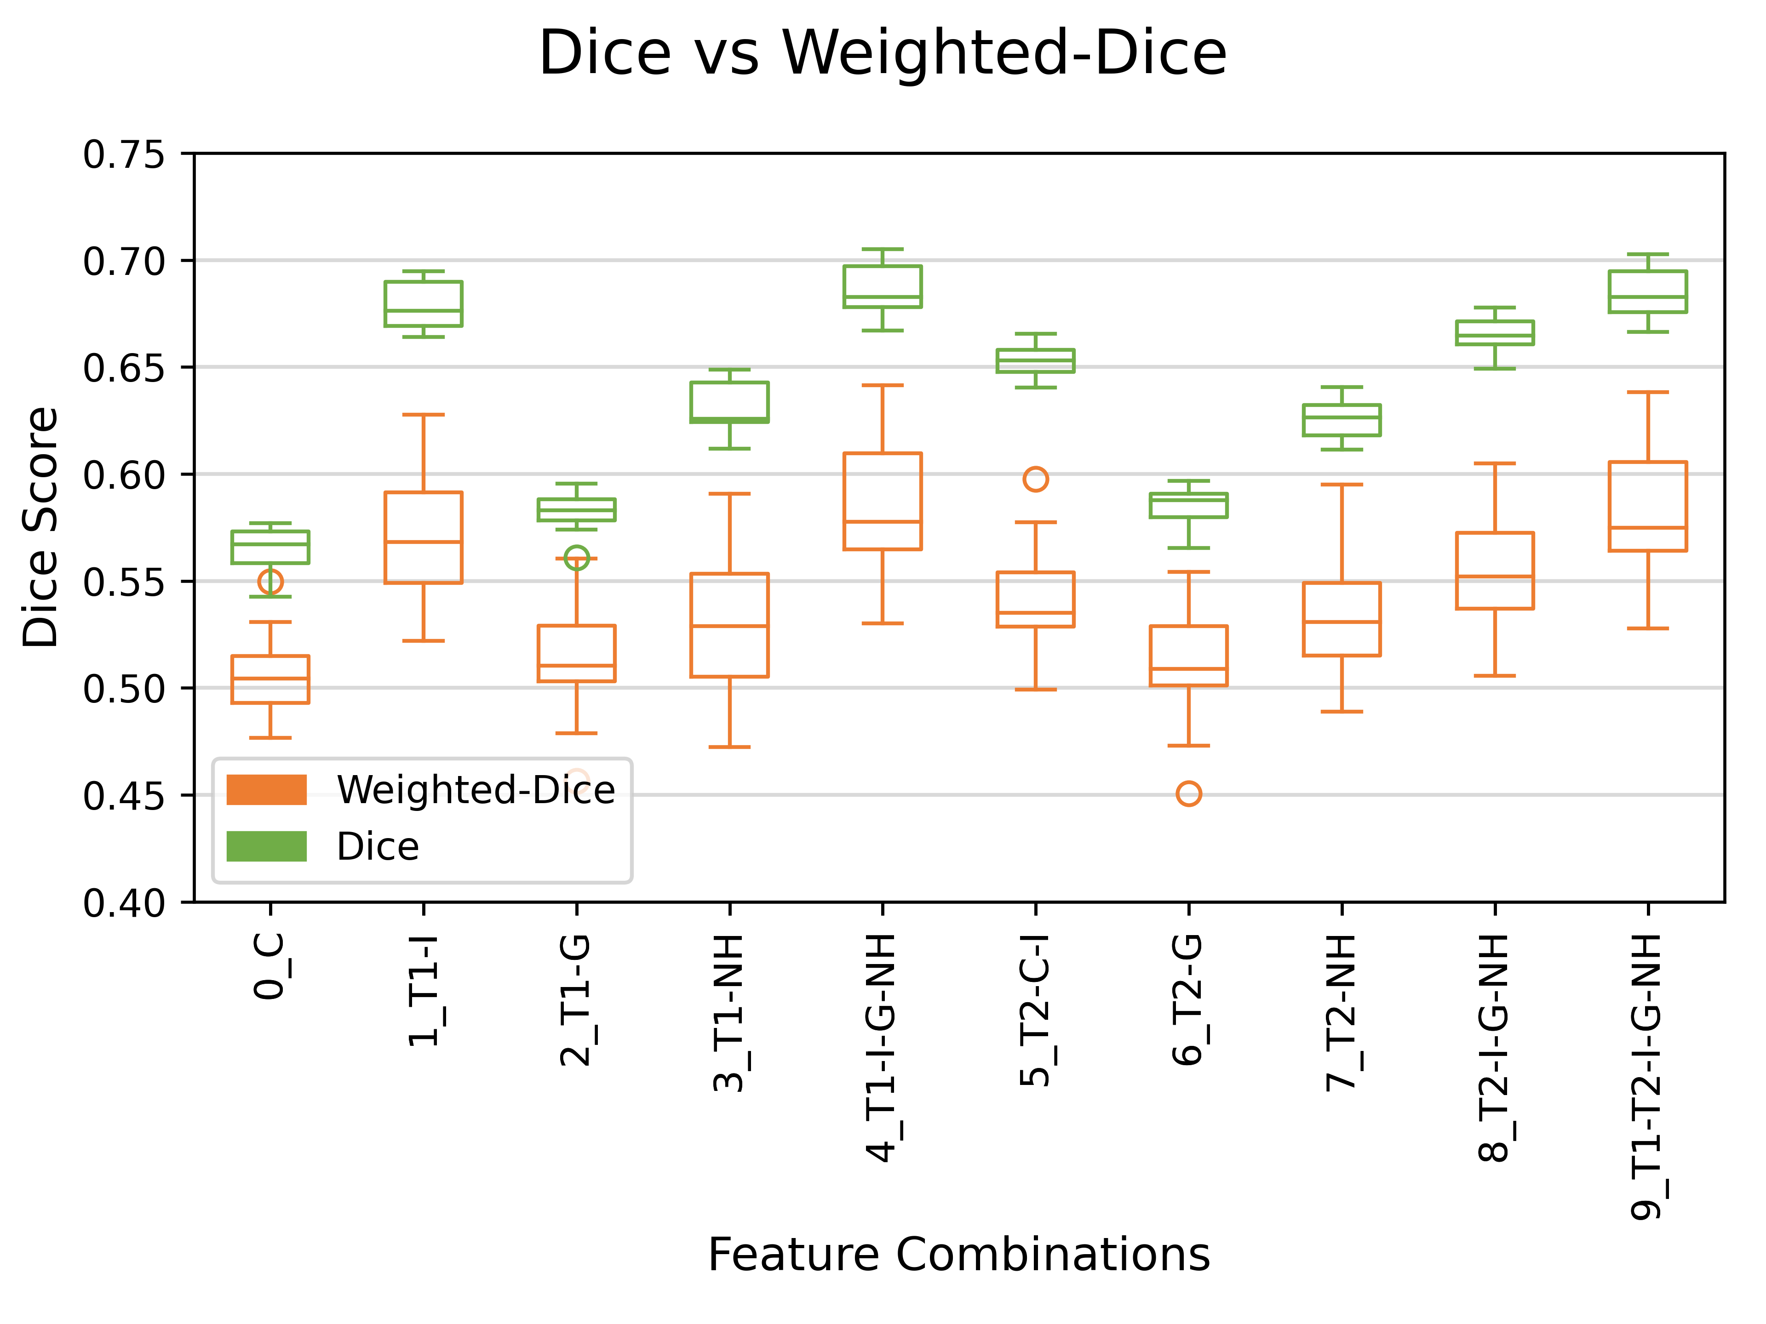
Notes:
- can see that intensity is the best
- just coordinate is the worst

Slide 16
Notes:
- why we take 04 and 09

Slide 17
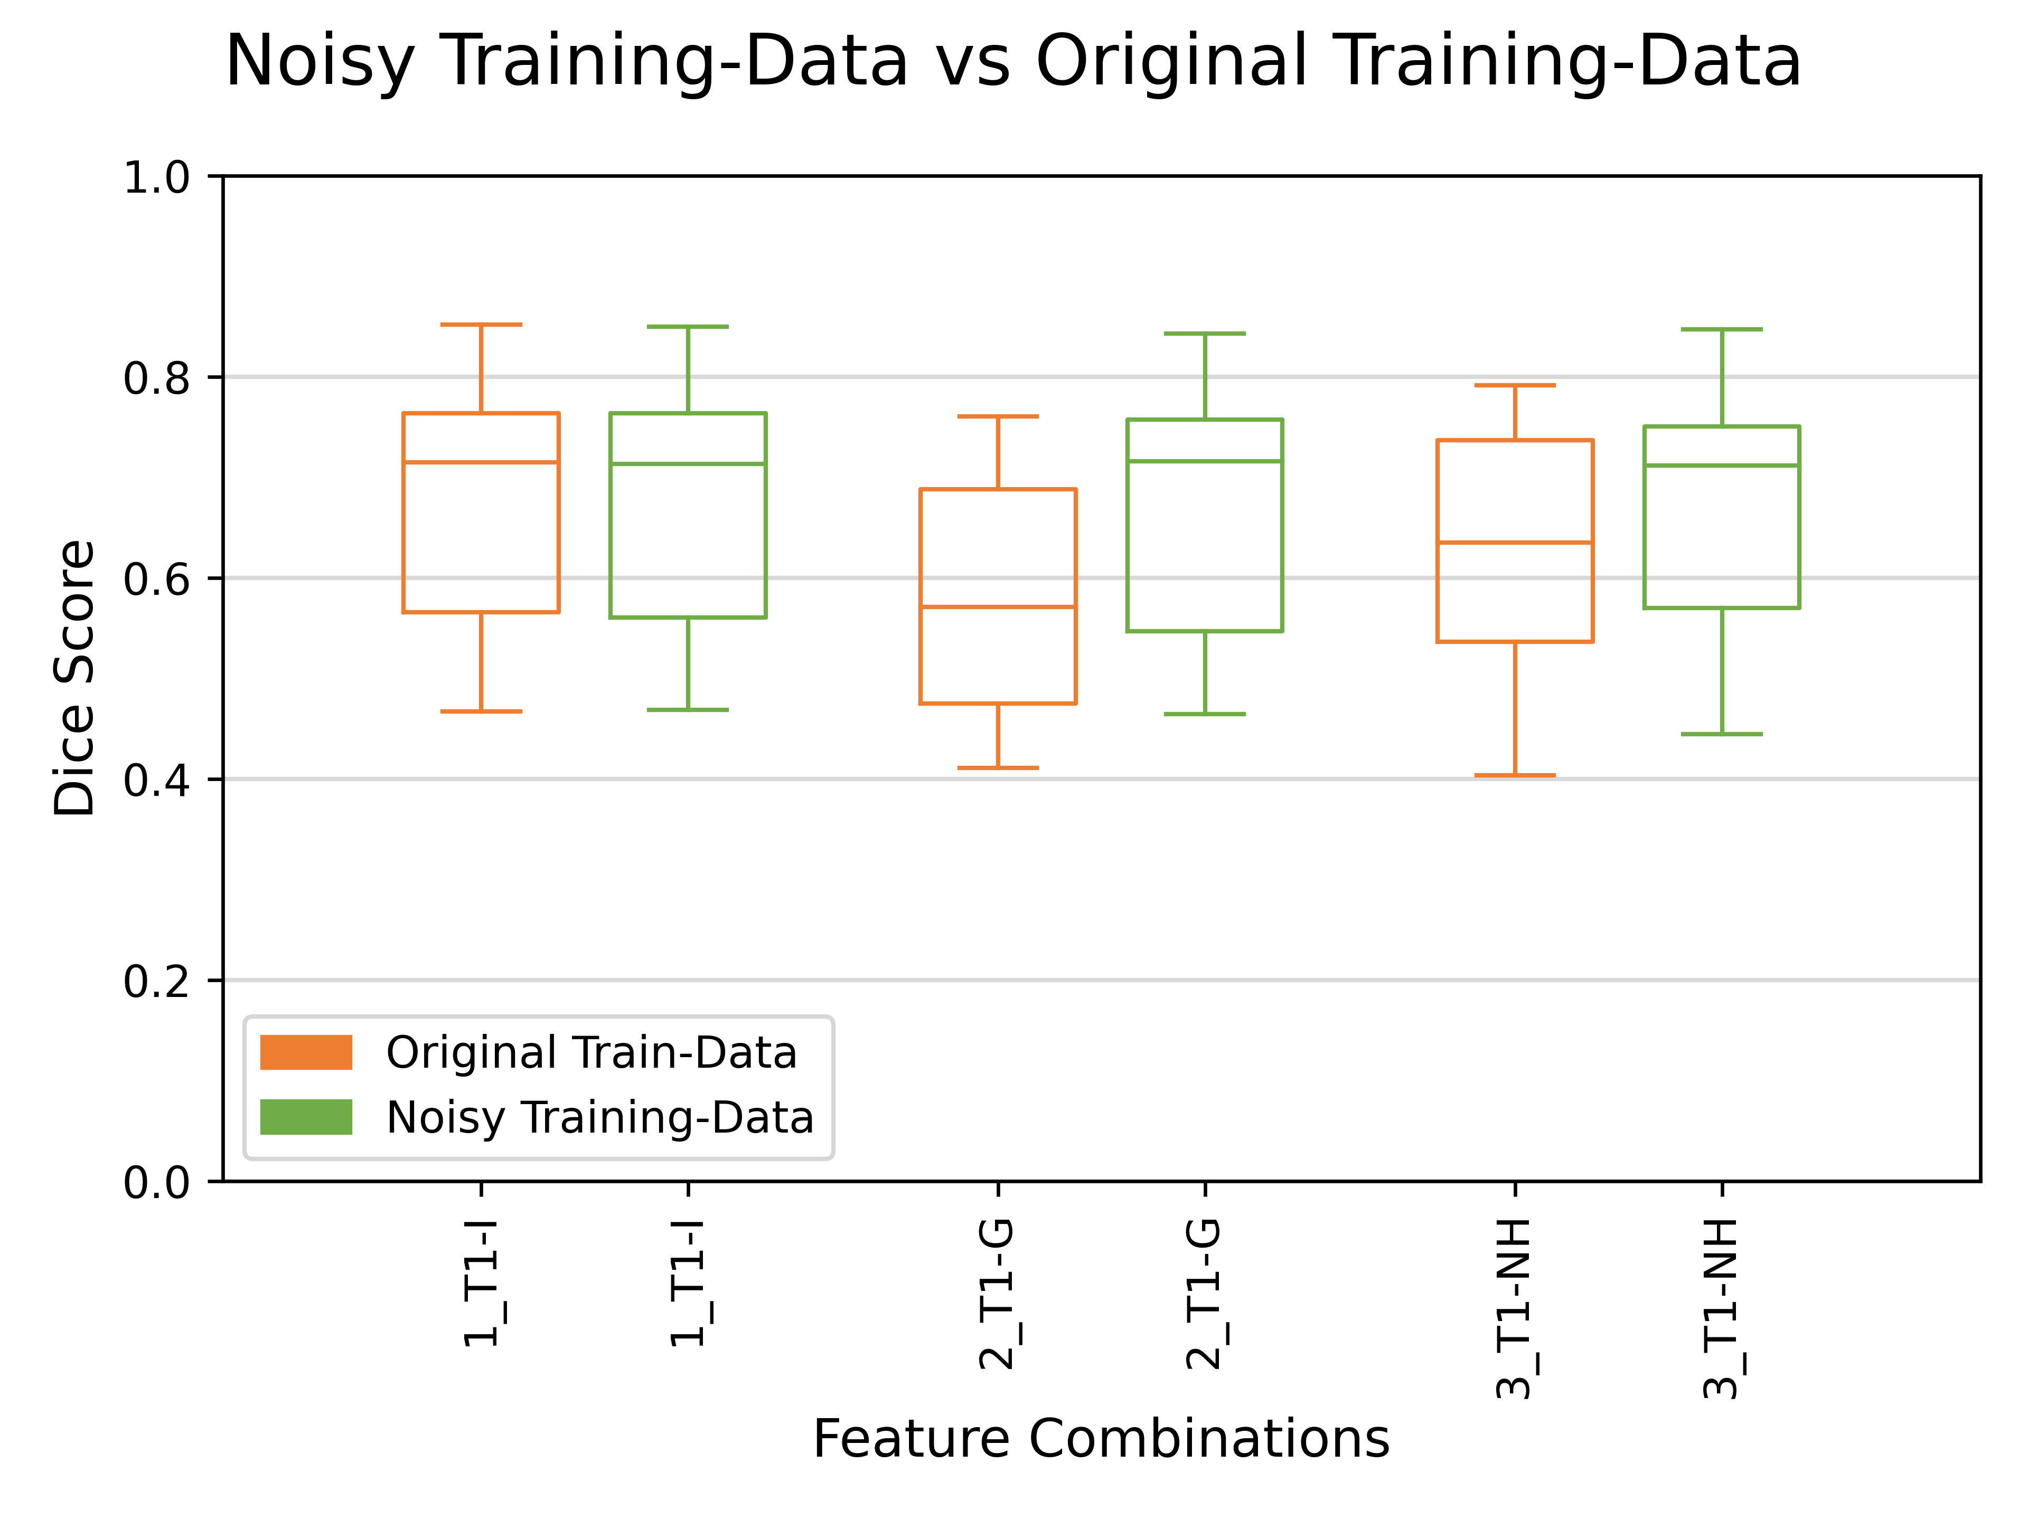

Slide 18
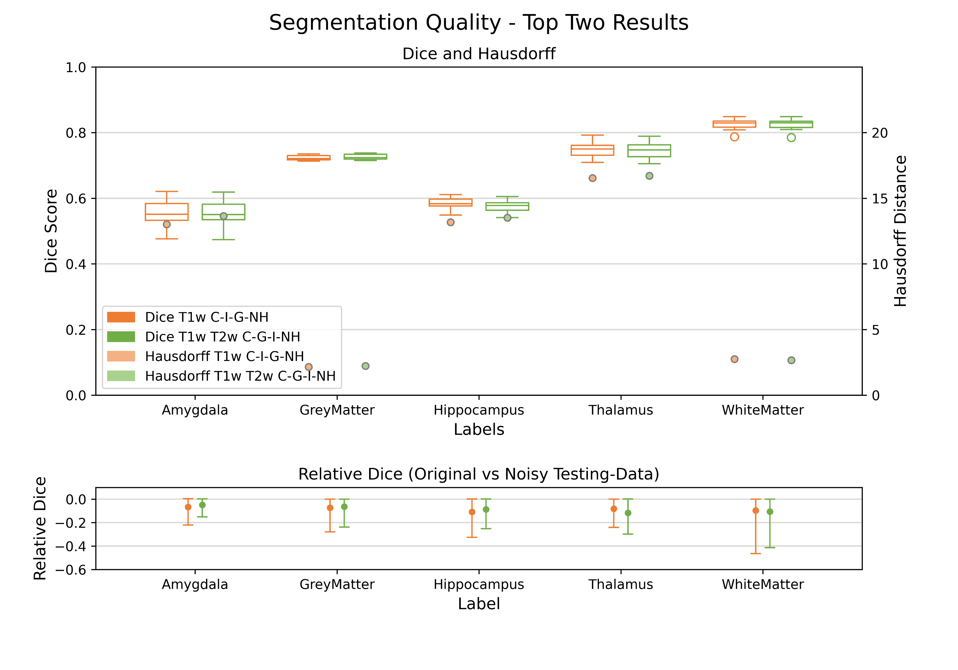

Slide 19
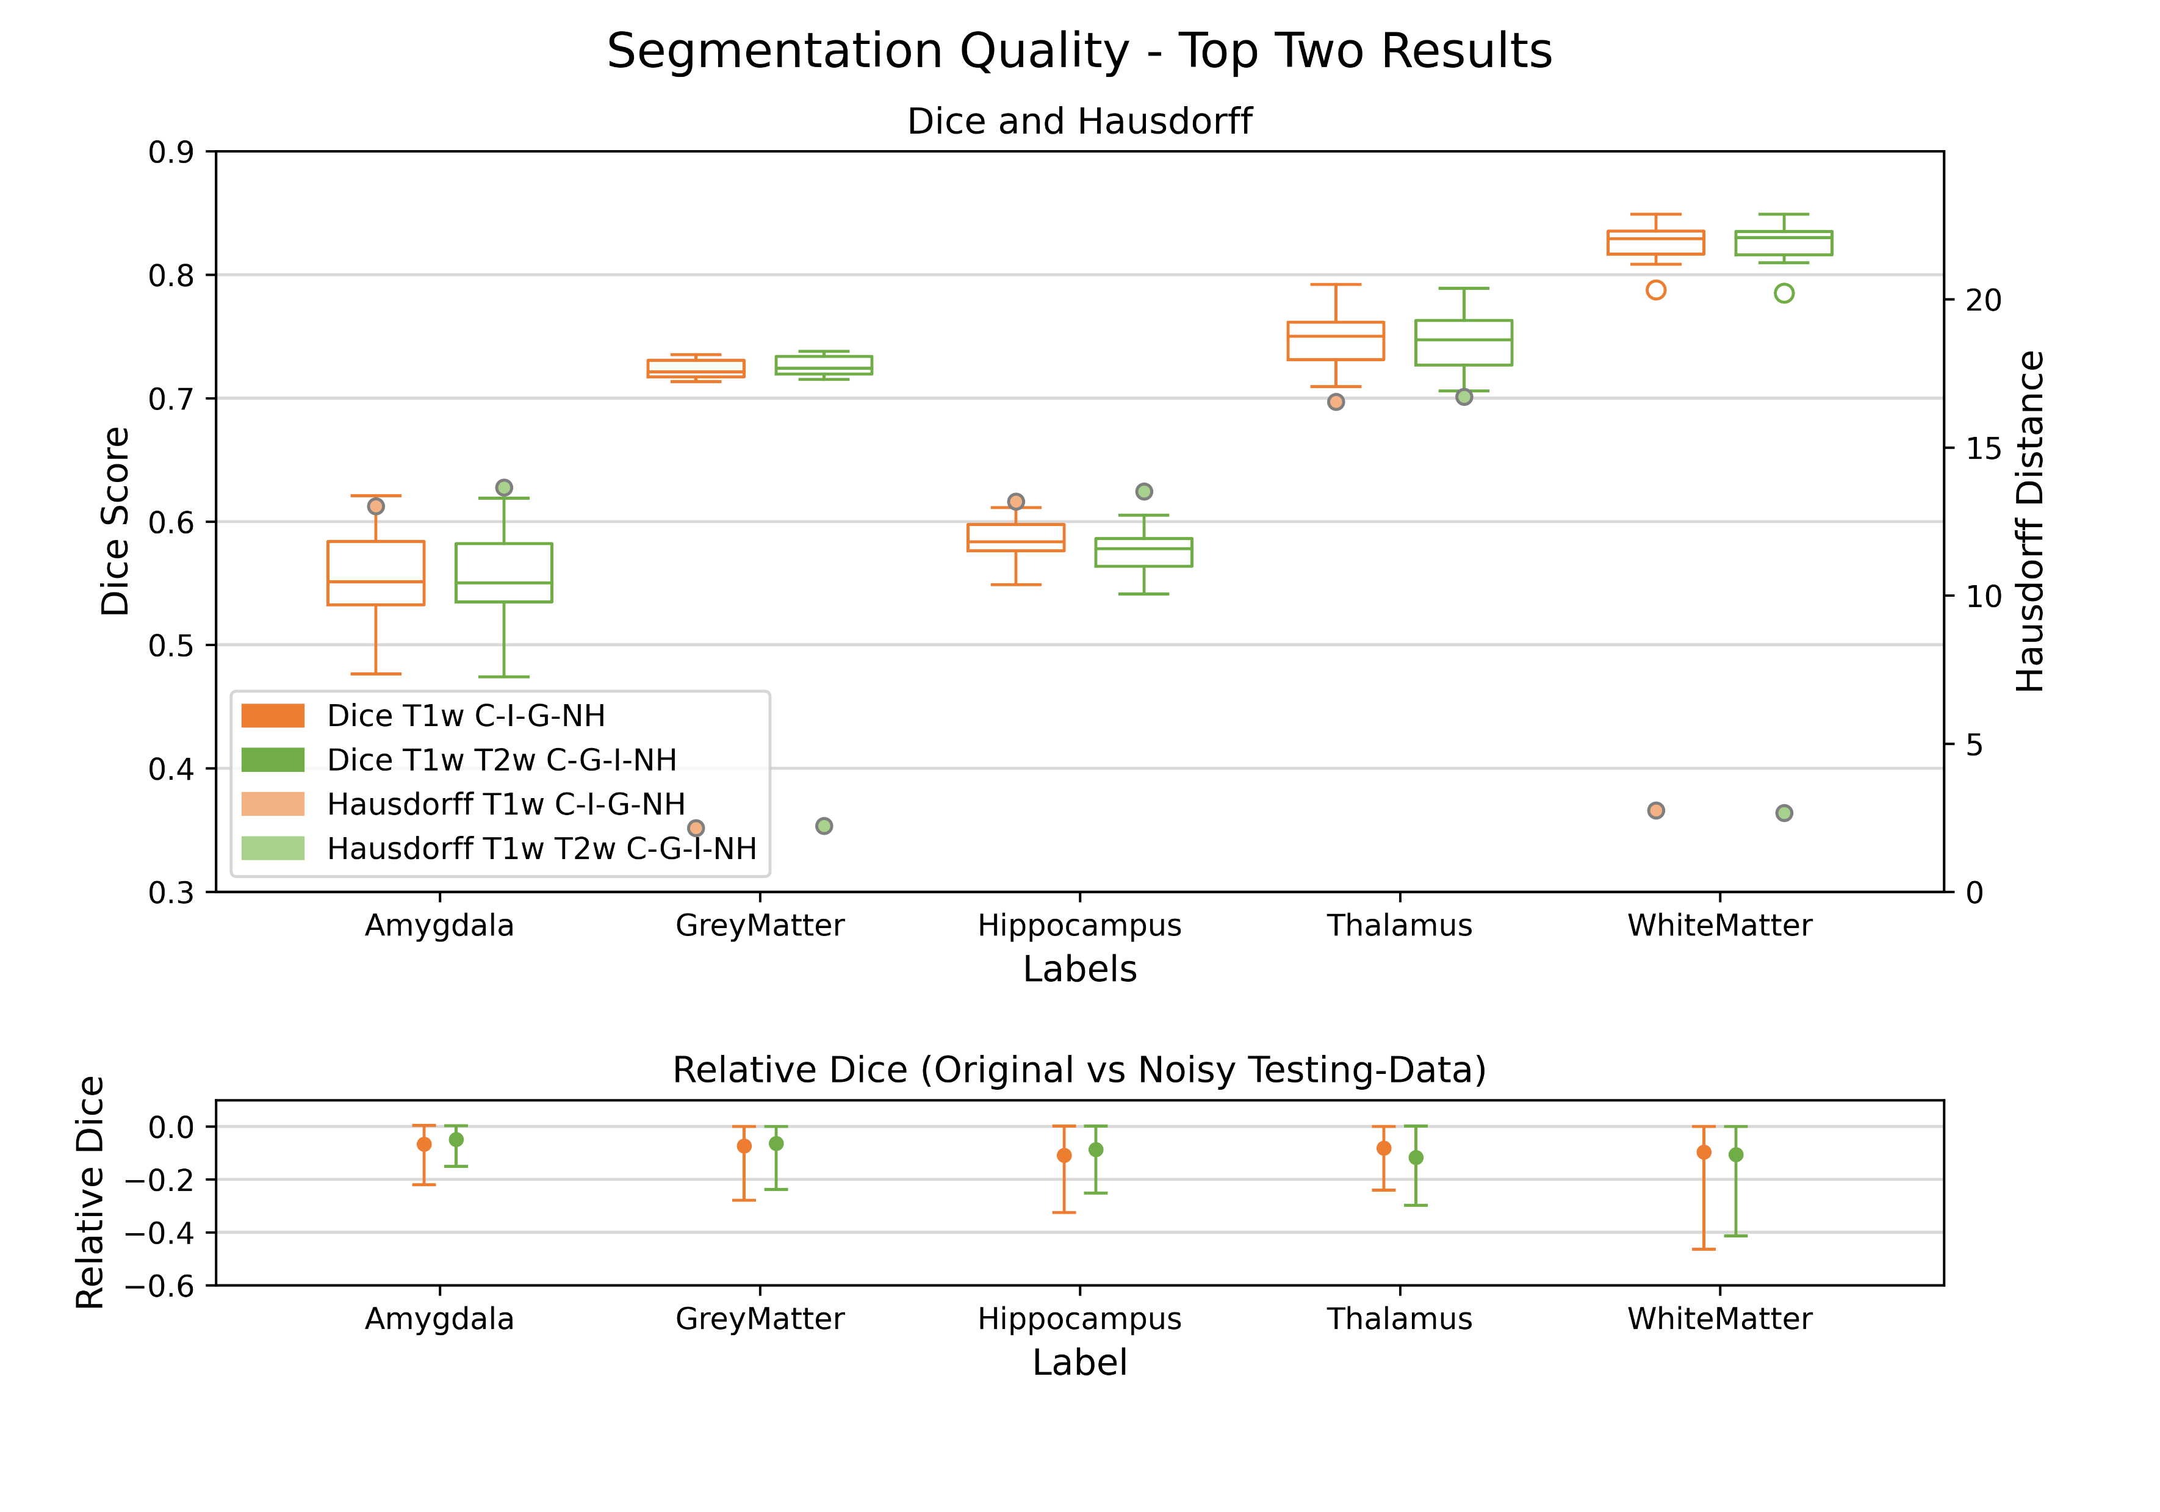

Slide 21
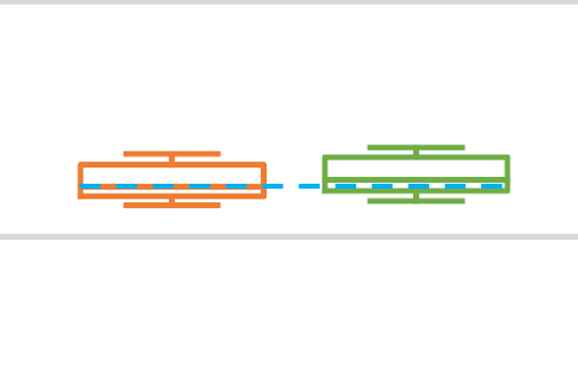
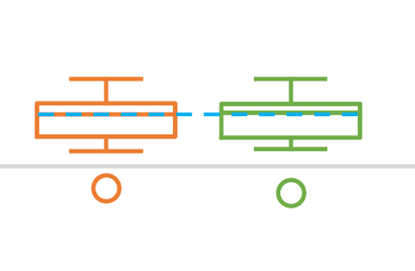
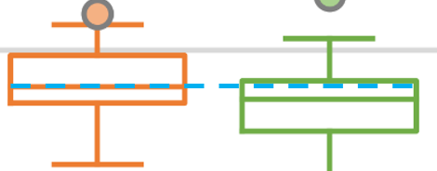
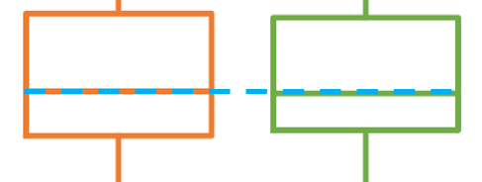
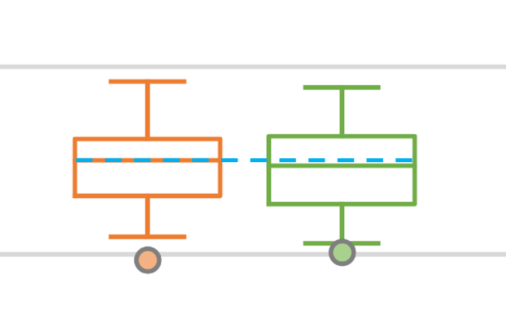

Slide 22
Median | T1w C-I-G-NH | T1w T2w C-I-G-NH
Amygdala | 0.5511 | 0.5502
Grey Matter | 0.7212 | 0.7241
Hippocampus | 0.5834 | 0.5781
Thalamus | 0.7500 | 0.7473
White Matter | 0.8292 | 0.8299
Average | 0.6870 | 0.6859
Mean | T1w C-I-G-NH | T1w T2w C-I-G-NH
Amygdala | 0.55234 | 0.5518
Grey Matter | 0.72339 | 0.7263
Hippocampus | 0.58435 | 0.5767
Thalamus | 0.74681 | 0.7454
White Matter | 0.82521 | 0.8251
Average | 0.6864 | 0.6851

Slide 23
Conclusion
T2w does not improve the Dice Score
Intensity-Feature is the most important Feature
Noisy Training data improves Dice but not robustness
Gray and White Matter reaches the highest Dice and the lowest Hausdorff-Distance

Slide 24
Hypothesis 6: A larger amount of features improves the segmentation performance

Slide 25
Hypothesis 6: A larger amount of features improves the segmentation performance
Rejected

Slide 26
Thanks for listening!

